Slide 1
Entity Relationship Diagram

Slide 2
Outline
What is an ERD?
Entities
Attributes
Relationships
Primary Keys
Foreign Keys

Slide 3




Database
A collection of information that is organized for easy
Storage
Management
Updates
Retrieval

Slide 4
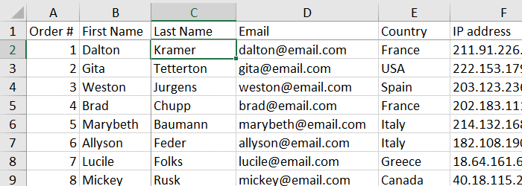

Slide 5
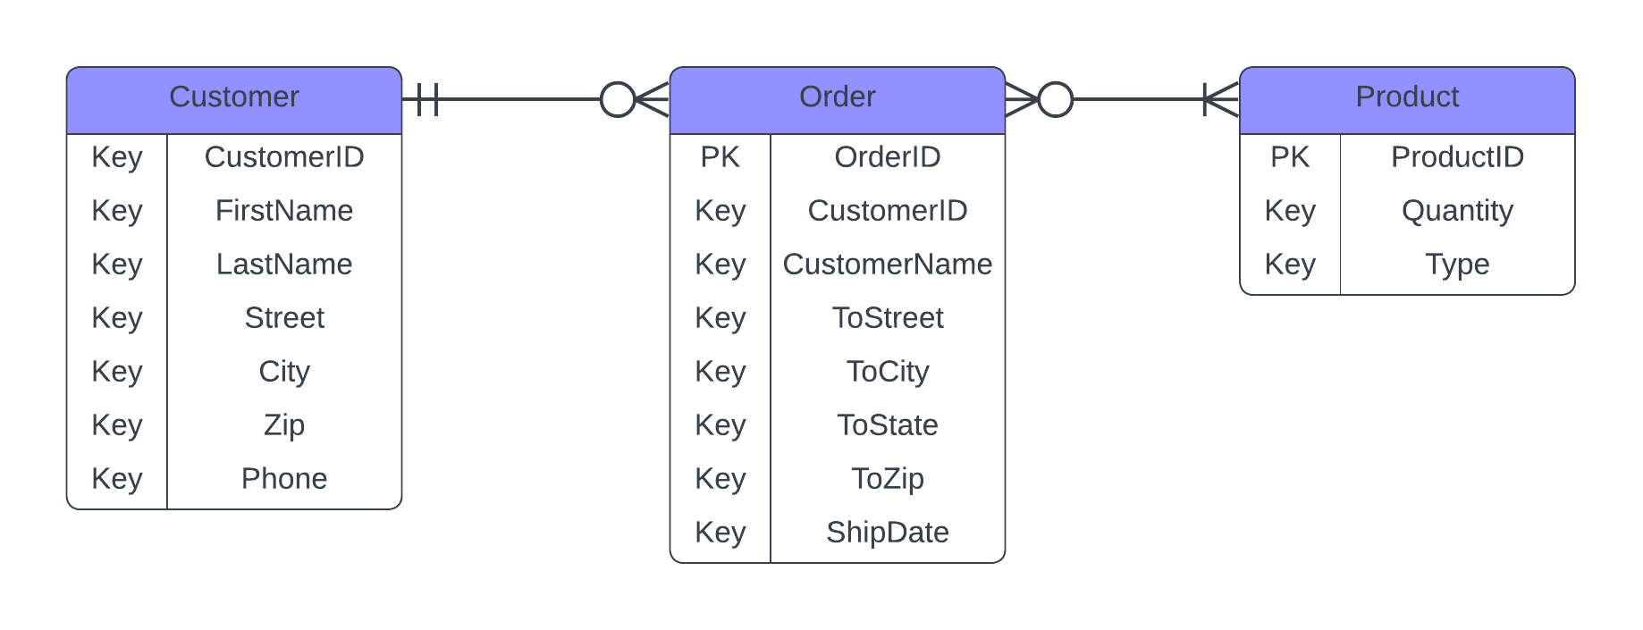
Entity Relationship Diagrams
ERD provides people with a visual way to understand how information in the database is related and how it works together

Slide 6



Entity
Is an object, like a
Person
Place
Thing
That is tracked in a database

Slide 7

For example, if we were to buy a shoe in Lazada

Slide 8
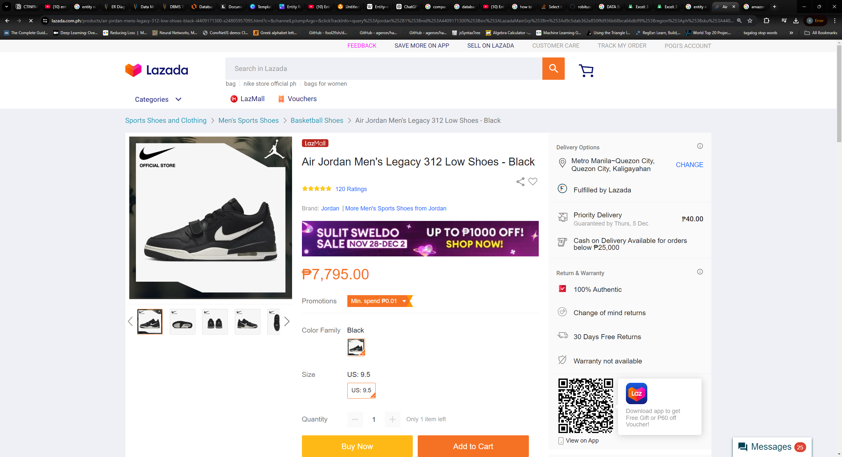

Slide 9
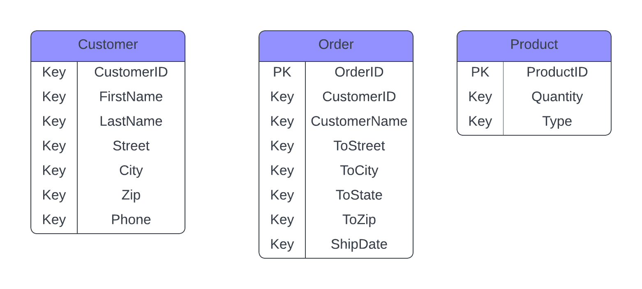
An Entity could be…

Slide 10
And each entities will have Attributes

Slide 11
Which are properties or traits.

Slide 12
 | Attribute | Attribute | Attribute | Attribute
Entity
Entity
Entity
Entity
Entity
Entity
Entity
It is important to note that entities in your database will always be depicted as rows

Slide 13
 | Attribute | Attribute | Attribute | Attribute
Entity
Entity
Entity
Entity
Entity
Entity
Entity
And Attributes will always be depicted as columns

Slide 14
Customer
 | Customer ID | FirstName | LastName | Street | City | Zip | Phone
Entity | 001 | Elizer | Ponio | Gil Puyat | Makati | 1124 | 1800-123
Entity | 002 | Juan | Dela Cruz | P. Zamora | Pasay | 1145 | 1800-123
Entity | 003 | Maria | Delos Santos | P. Burgos | Taguig | 1156 | 1800-123

Slide 15
And now that we have these entities and
attributes

Slide 16
We can talk about the relationships that exist between them

Slide 17
Relationships
Describe how entities interact with each other.

Slide 18

When you see a line between these entities

Slide 19
It is showing that there is some connection

Slide 20
Now that we have our relationships in place.

Slide 21
We will see an interesting notation attached to our lines

Slide 22
This is called cardinality

Slide 23
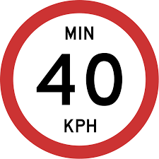
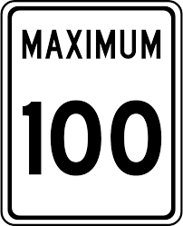
Cardinalities
Helps define the relationship in a numerical context.

Slide 24
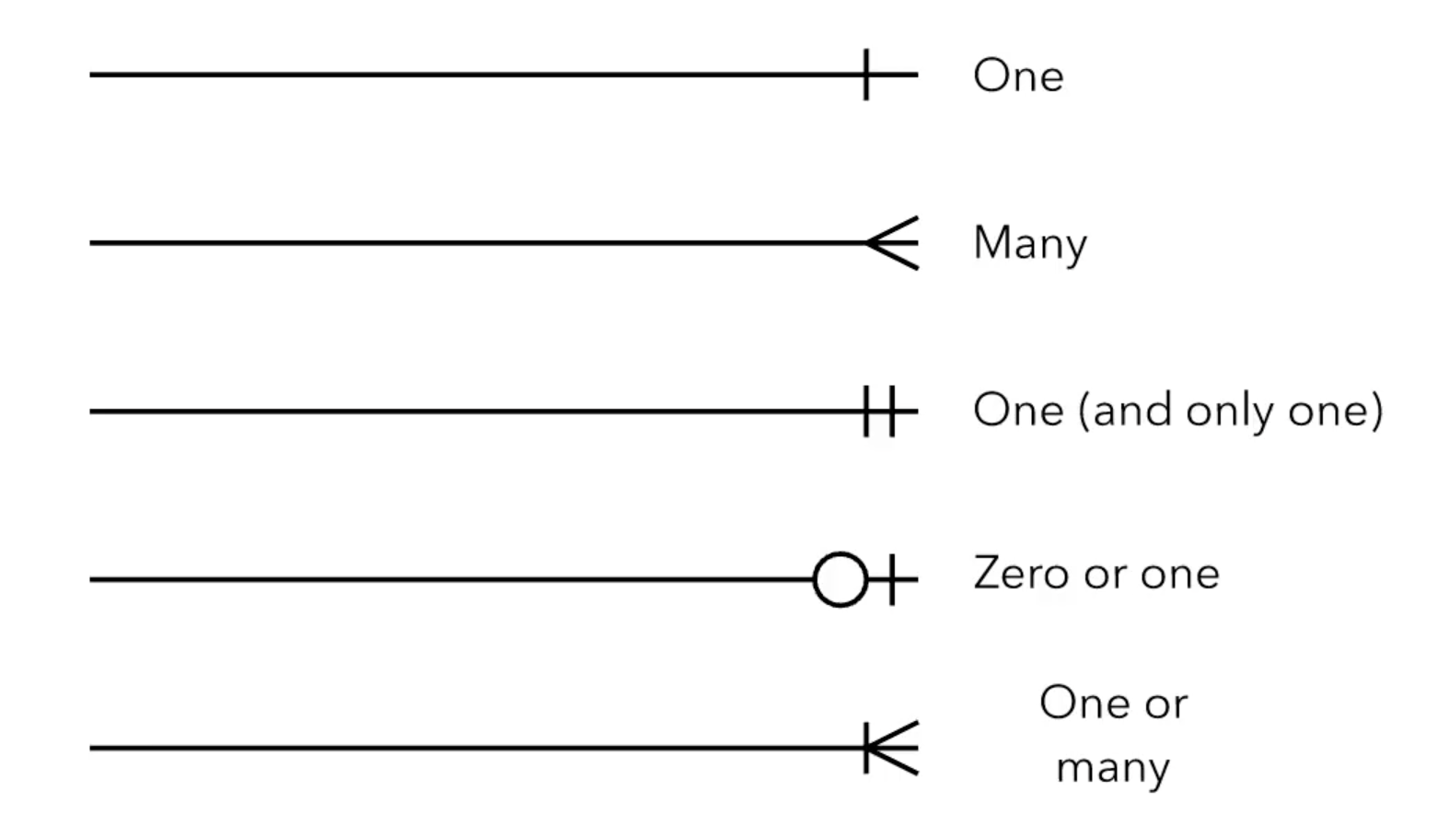

Slide 25
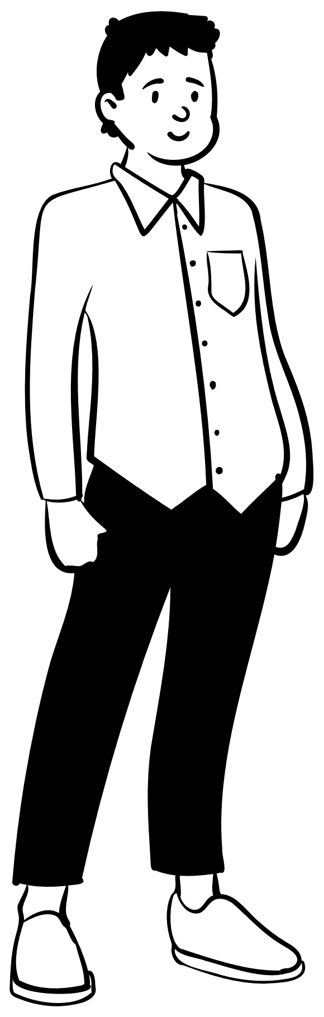

Let start by talking about the relationship and cardinality that exist between customer and order

Slide 26
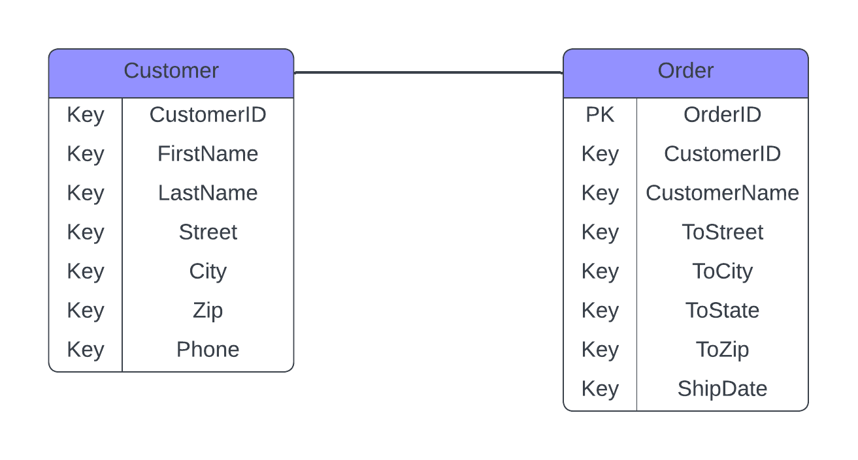
The best way to do this is to think about it logically.
So we should ask ourselves two questions

Slide 27
1. “What is the minimum number of orders that a customer could have?”
min

Slide 28
2. What is the maximum number or orders that a customer may have?
min
max

Slide 29
For the minimum, a customer could exist, but he or she could have zero orders.
min
max

Slide 30
For the maximum, a customer can have an infinite number of orders!
min
max

Slide 31
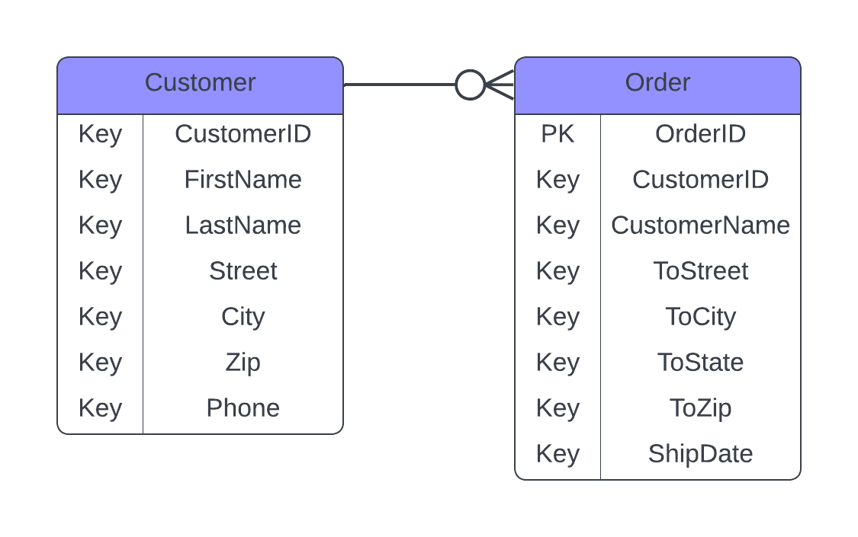

A customer can have zero or many orders

Slide 32
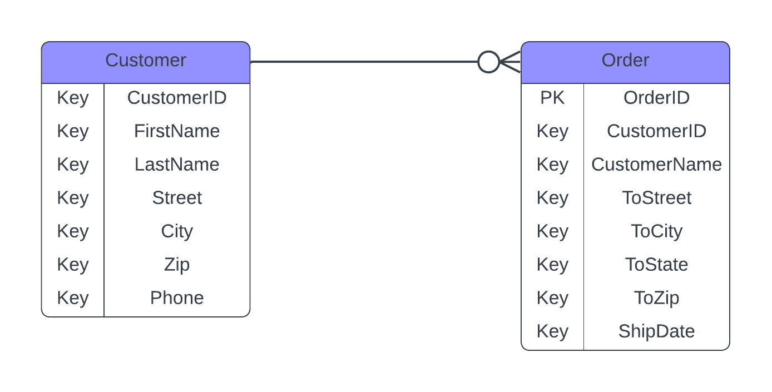
Now, lets talk about the minimum and maximum relationship between orders and customers
max
min

Slide 33
We will start by applying the same logic and ask ourselves two questions
max
min

Slide 34
“What is the minimum amount of customers an order may have”
max
min

Slide 35
and “What is the maximum number of customers that an order may have?”
max
min

Slide 36
A specific order can only have one and only one customer
max
min

Slide 37


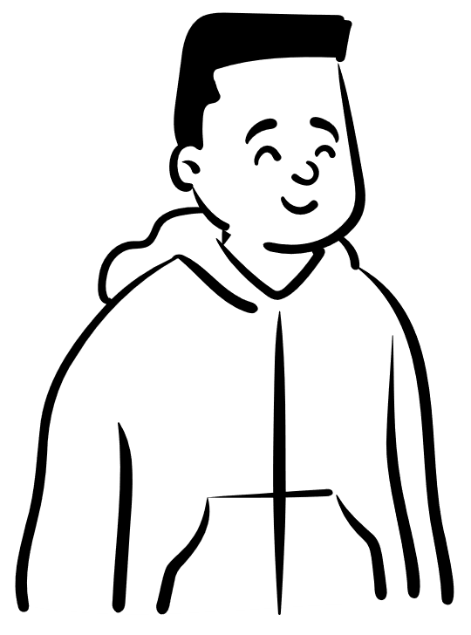
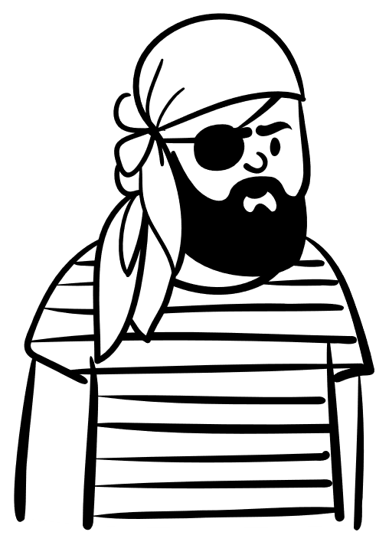
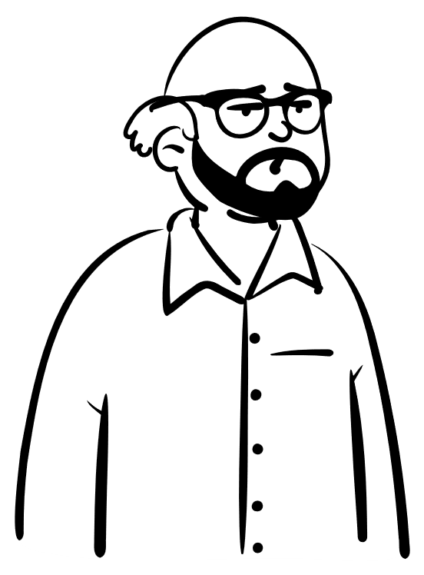
Image the confusion that it would create if the same specific order had a lot of customers.
Order Number: 100

Slide 38
So in this case, there can only be one and only one number of customers in an order
Order Number: 100

Slide 39
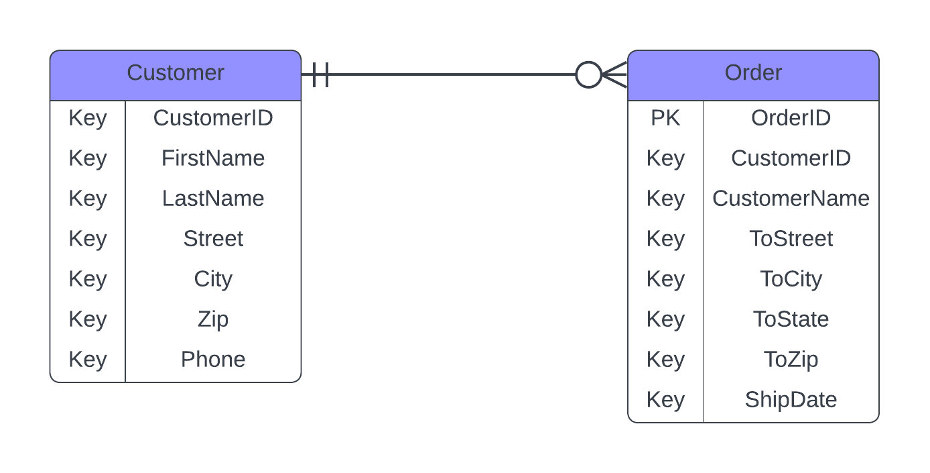
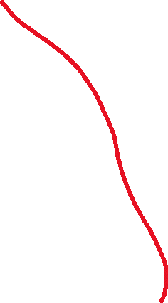
We show this relationship by using this one-to-one sign

Slide 40
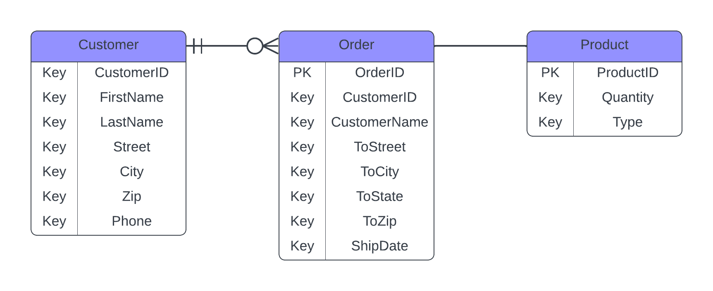

Finally, let us talk about the relationship and cardinality between orders and product

Slide 41
We will ask ourselves a similar question.
A certain order can have how many products?

Slide 42
Well, for an order to exist, it must have one product.
But a lot of products can be part of that order

Slide 43
Well, for an order to exist, it must have one product.
But a lot of products can be part of that order

Slide 44
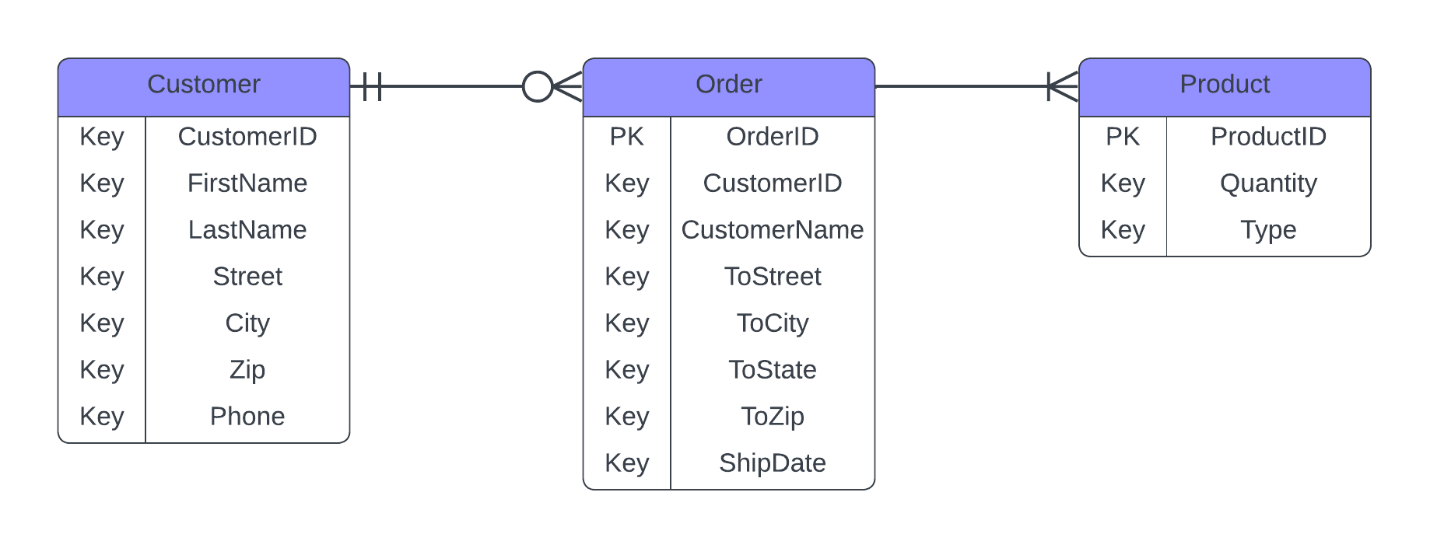

We show this by using the one or many sign

Slide 45
Now we will ask ourselves that question in reverse.
A product can be part of how many orders?

Slide 46
Well, a product could be a part of no orders

Slide 47
But it could also be a product of many orders

Slide 48

We show this by using the zero or many symbol

Slide 49
This is now our Entity Relationship Diagram

Slide 50
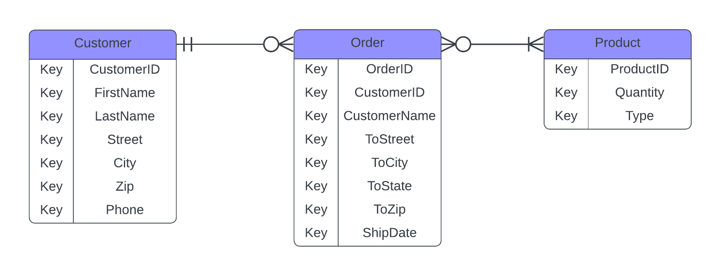

Slide 52
Customer Table
Customer ID | FirstName | LastName | Street | City | Zip | Phone
001 | Elizer | Ponio | Gil Puyat | Makati | 1124 | 1800-123
002 | Juan | Dela Cruz | P. Zamora | Pasay | 1145 | 1800-123
003 | Maria | Delos Santos | P. Burgos | Taguig | 1156 | 1800-123

Slide 53
Remember that each entity in our diagram represents a table in our database

Slide 54
Customer
Order
Product

Slide 55
Customer
Customer ID | FirstName | LastName | Street | City | Zip | Phone
001 | Elizer | Ponio | Gil Puyat | Makati | 1124 | 1800-123
002 | Juan | Dela Cruz | P. Zamora | Pasay | 1145 | 1800-123
003 | Maria | Delos Santos | P. Burgos | Taguig | 1156 | 1800-123
In real world databases, we will have different instances of customers.

Slide 56
Customer
Customer ID | FirstName | LastName | Street | City | Zip | Phone
001 | Elizer | Ponio | Gil Puyat | Makati | 1124 | 1800-123
002 | Juan | Dela Cruz | P. Zamora | Pasay | 1145 | 1800-123
003 | Maria | Delos Santos | P. Burgos | Taguig | 1156 | 1800-123
Just image if we manage a database for Lazada

Slide 57
Customer
Customer ID | FirstName | LastName | Street | City | Zip | Phone
001 | Elizer | Ponio | Gil Puyat | Makati | 1124 | 1800-123
002 | Juan | Dela Cruz | P. Zamora | Pasay | 1145 | 1800-123
003 | Maria | Delos Santos | P. Burgos | Taguig | 1156 | 1800-123
We will have millions of customers in this table

Slide 58
Customer
Customer ID | FirstName | LastName | Street | City | Zip | Phone
001 | Elizer | Ponio | Gil Puyat | Makati | 1124 | 1800-123
002 | Juan | Dela Cruz | P. Zamora | Pasay | 1145 | 1800-123
003 | Maria | Delos Santos | P. Burgos | Taguig | 1156 | 1800-123
For a table that is very large, we need to use something to distinguish who’s who in this massive table.

Slide 59
Customer
Customer ID | FirstName | LastName | Street | City | Zip | Phone
001 | Elizer | Ponio | Gil Puyat | Makati | 1124 | 1800-123
002 | Juan | Dela Cruz | P. Zamora | Pasay | 1145 | 1800-123
003 | Maria | Delos Santos | P. Burgos | Taguig | 1156 | 1800-123
This is where a primary key comes in!

Slide 60
Primary Key
An attribute or a field that uniquely identifies every record within a certain table

Slide 61
So for this Customer table, the primary key is going to be a value that makes every customer distinct from any other customer
Customer
Customer ID | FirstName | LastName | Street | City | Zip | Phone
001 | Elizer | Ponio | Gil Puyat | Makati | 1124 | 1800-123
002 | Juan | Dela Cruz | P. Zamora | Pasay | 1145 | 1800-123
003 | Maria | Delos Santos | P. Burgos | Taguig | 1156 | 1800-123

Slide 62
Primary Key Rules
A primary key has to be unique and identify with only one record in our table
It needs to be never changing
A primary key needs to be never null

Slide 63
We cannot use FirstName and LastName because it is possible to have a customer that have identical first names and last names
Customer
Customer ID | FirstName | LastName | Street | City | Zip | Phone
001 | Elizer | Ponio | P. Zamora | Pasay | 1124 | 1800-123
002 | Juan | Dela Cruz | P. Zamora | Pasay | 1145 | 1800-123
003 | Elizer | Ponio | P. Burgos | Taguig | 1156 | 1800-123

Slide 64
We cannot also use the address because two different customers could live at the same address not to mention that customer could move homes at any time.
Customer
Customer ID | FirstName | LastName | Street | City | Zip | Phone
001 | Elizer | Ponio | P. Zamora | Pasay | 1124 | 1800-123
002 | Juan | Dela Cruz | P. Zamora | Pasay | 1145 | 1800-123
003 | Elizer | Ponio | P. Burgos | Taguig | 1156 | 1800-123

Slide 65
A customer could also change their phone number at any time.
Customer
Customer ID | FirstName | LastName | Street | City | Zip | Phone
001 | Elizer | Ponio | P. Zamora | Pasay | 1124 | 1800-123
002 | Juan | Dela Cruz | P. Zamora | Pasay | 1145 | 1800-123
003 | Elizer | Ponio | P. Burgos | Taguig | 1156 | 1800-123

Slide 66
Leaving us with the CustomerID. By design, any ID is typically programmed to increment for each addition to the table.
Customer
Customer ID | FirstName | LastName | Street | City | Zip | Phone
001 | Elizer | Ponio | P. Zamora | Pasay | 1124 | 1800-123
002 | Juan | Dela Cruz | P. Zamora | Pasay | 1145 | 1800-123
003 | Elizer | Ponio | P. Burgos | Taguig | 1156 | 1800-123

Slide 67
Because of this, the value in CustomerID will never be repeated in this table. So we are good to make CustomerID our primary key
Customer
Customer ID | FirstName | LastName | Street | City | Zip | Phone
001 | Elizer | Ponio | P. Zamora | Pasay | 1124 | 1800-123
002 | Juan | Dela Cruz | P. Zamora | Pasay | 1145 | 1800-123
003 | Elizer | Ponio | P. Burgos | Taguig | 1156 | 1800-123

Slide 68
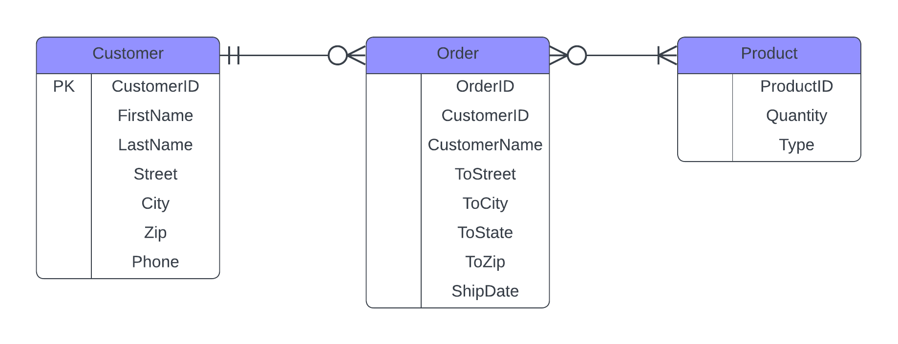

Primary Keys are typically indicated in ERDs by using PK besides the attribute

Slide 69
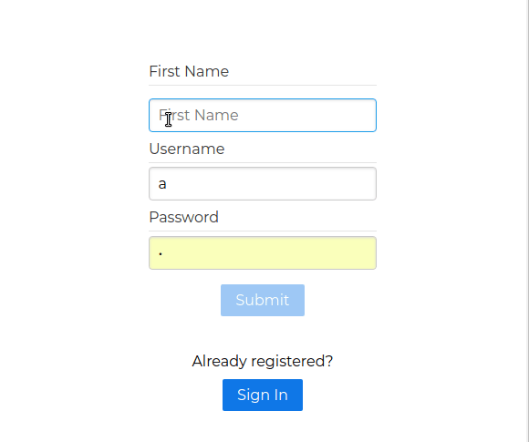
The reason why you cannot register an account using the same email address is because the database uses your email address as the primary key

Slide 70
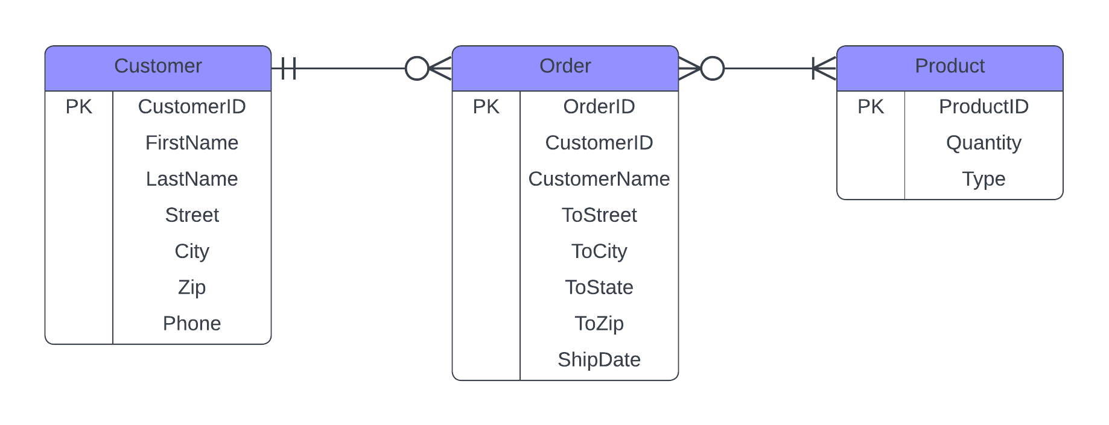


For the Order and Product, we will use OrderID and ProductID as the primary key,

Slide 71
We now have primary keys that are unique, never changing and never null

Slide 72
Foreign Key
The same as a primary key. It’s just located in a foreign place.

Slide 73
You may notice that the CustomerID from the Customer entity is also in the Order entity. Why??

Slide 74
Because for each order, we want to know which customer placed that order

Slide 75
The order entity is simply referencing the CustomerID from the customer entity

Slide 76


That makes it a foreign key here so we will mark it with FK

Slide 77
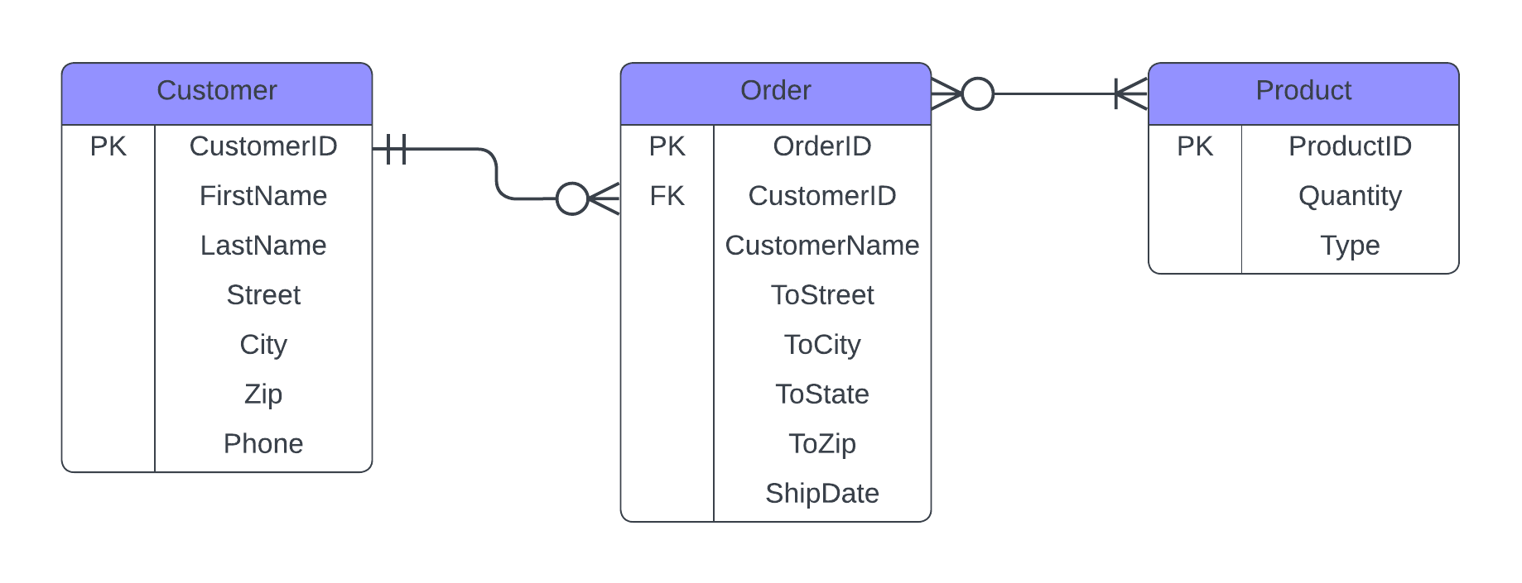

And we can further show this relationship in our diagram by adjusting the line up with the primary and foreign key

Slide 78

This helps visually reinforce the fact that foreign key in the Order entity is referencing the primary key of the Customer entity

Slide 79
Foreign Key Rules
Unlike a primary key, a foreign key does not have to be unique. It can be repeated inside a table.

Slide 80
If Elizer is an avid shopper, his CustomerID is going to be repeated a lot!
Order
OrderID | CustomerID | CustomerName | ToStreet | ToCity | ToState | ToZip | ShipDate
001 | 001 | Elizer Ponio | P. Zamora | Pasay | NCR | 1124 | 01-01-25
002 | 002 | Juan Dela Cruz | P. Zamora | Pasay | NCR | 1145 | 01-02-25
003 | 001 | Elizer Ponio | P. Zamora | Pasay | NCR | 1124 | 01-01-30

Slide 81
Foreign Key Rules
Unlike a primary key, a foreign key does not have to be unique. It can be repeated inside a table.
It is possible to have multiple foreign keys in one entity

Slide 82
Let us say that for each order, we also want to know the product that is being sold
Order
OrderID | CustomerID | CustomerName | ToStreet | ToCity | ToState | ToZip | ShipDate | ProductID
001 | 001 | Elizer Ponio | P. Zamora | Pasay | NCR | 1124 | 01-01-25 | 001
002 | 002 | Juan Dela Cruz | P. Zamora | Pasay | NCR | 1145 | 01-02-25 | 002
003 | 001 | Elizer Ponio | P. Zamora | Pasay | NCR | 1124 | 01-01-30 | 003

Slide 83
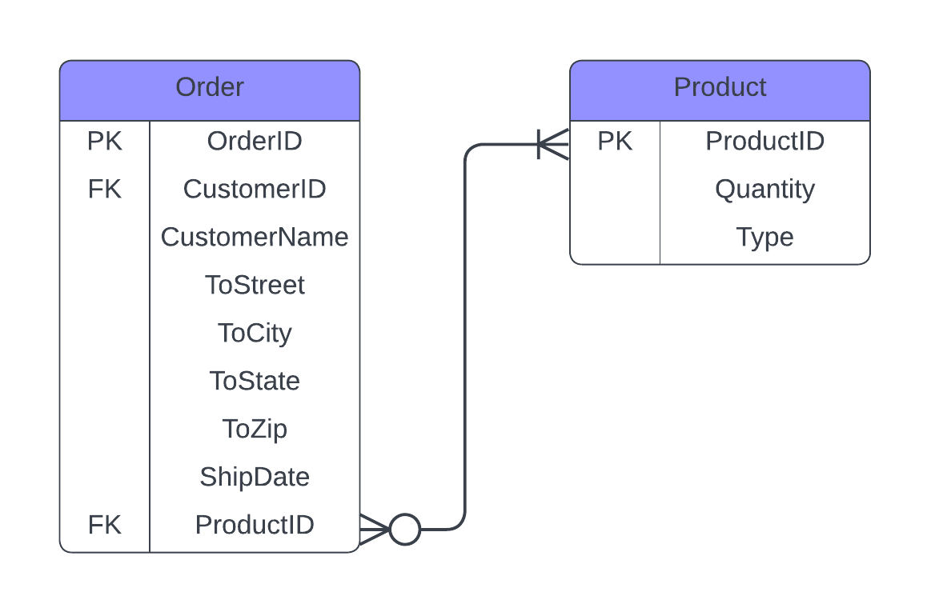
We will just add the ProductID attribute in the Order entity and link it to the Product Entity

Slide 84
Now we have two foreign keys in our Order Entity

Slide 85
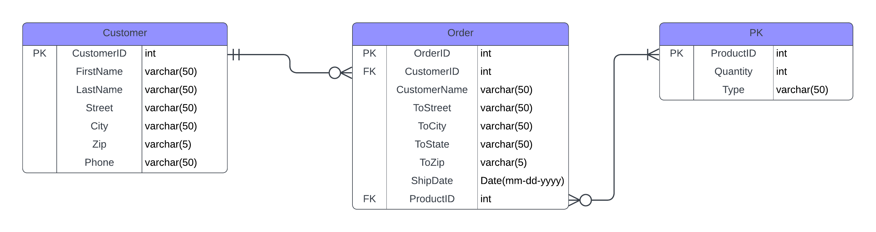
For a more detailed diagram, we can also add the datatype and constraint for each attribute

